Slide 1
Chapter 11:
Inheritance and Composition

Slide 2
Objectives
In this chapter, you will:
  Learn about inheritance
  Learn about derived and base classes
  Redefine the member functions of a base class
  Examine how the constructors of base and derived classes work
  Learn how to construct the header file of a derived class
C++ Programming: From Problem Analysis to Program Design, Sixth Edition

Slide 3
Objectives (cont’d.)
In this chapter, you will (cont’d.):
  Learn about the C++ stream hierarchy
  Explore three types of inheritance: public, protected, and private
  Learn about composition (aggregation)
  Become familiar with the three basic principles of object-oriented design
C++ Programming: From Problem Analysis to Program Design, Sixth Edition

Slide 4
Introduction
Two common ways to relate two classes in a meaningful way are:
  Inheritance (“is-a” relationship)
  Composition, or aggregation: (“has-a” relationship)
C++ Programming: From Problem Analysis to Program Design, Sixth Edition

Slide 5
Inheritance
Inheritance: “is-a” relationship
  Example: “every employee is a person”
Inheritance allows creation of new classes from existing classes
  Derived classes: new classes created from the existing class
  Base class: the original class
Derived class inherits the properties of its base classes
C++ Programming: From Problem Analysis to Program Design, Sixth Edition

Slide 6
Inheritance (cont’d.)
Inheritance helps reduce software complexity
Single inheritance: derived class has a single base class
Multiple inheritance: derived class has more than one base class
Public inheritance: all public members of base class are inherited as public members by derived class
C++ Programming: From Problem Analysis to Program Design, Sixth Edition

Slide 7
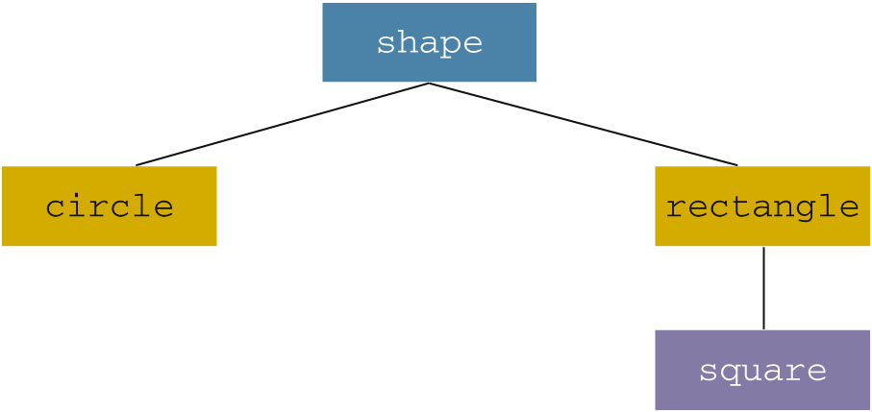
Inheritance (cont’d.)
Inheritance can be viewed as a tree-like, or hierarchical, structure between the base class and its derived classes
C++ Programming: From Problem Analysis to Program Design, Sixth Edition

Slide 8
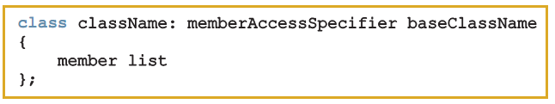
Inheritance (cont’d.)
Syntax of a derived class:
  memberAccessSpecifier is public, protected, or private (default)
private members of a base class are private to the base class
  Derived class cannot directly access them
C++ Programming: From Problem Analysis to Program Design, Sixth Edition

Slide 9
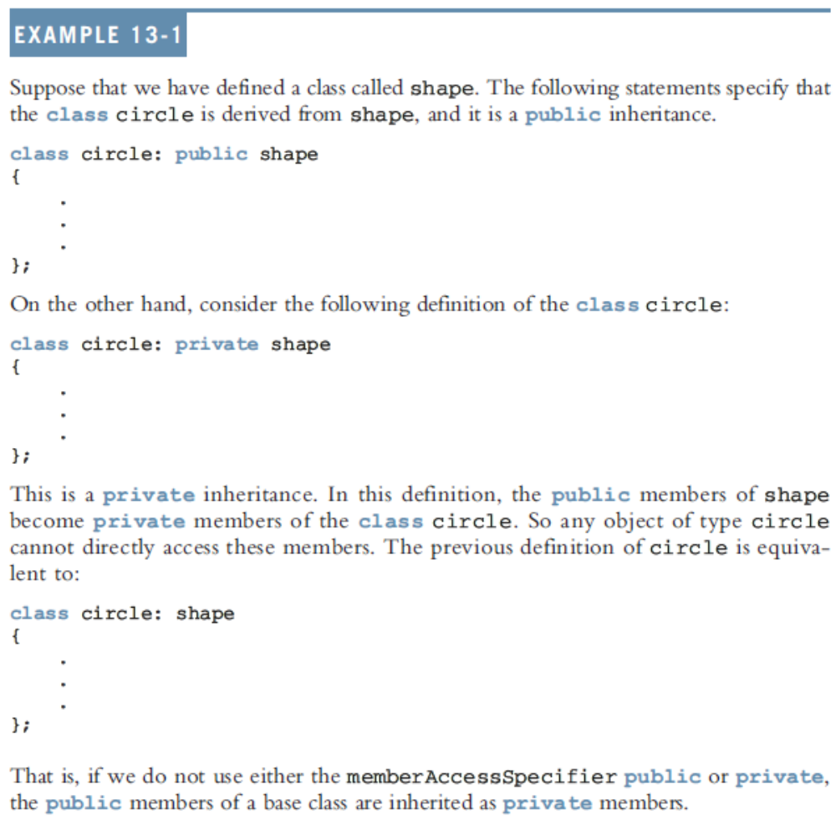
C++ Programming: From Problem Analysis to Program Design, Sixth Edition

Slide 10
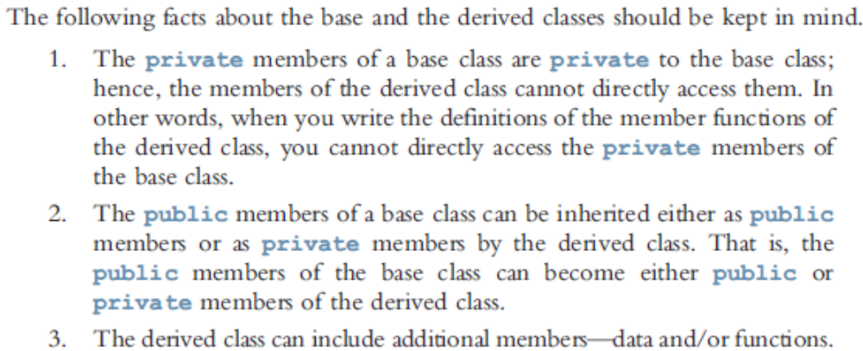
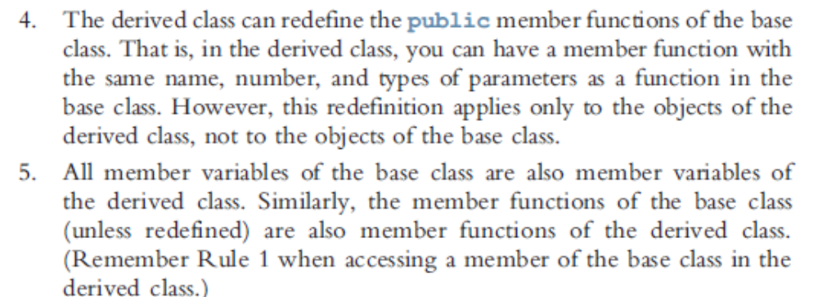
C++ Programming: From Problem Analysis to Program Design, Sixth Edition

Slide 11
Inheritance (cont’d.)
public members of base class can be inherited as public or private members
Derived class can include additional members (data and/or functions)
Derived class can redefine public member functions of the base class
  Applies only to the objects of the derived class
All members variables of the base class are also member variables of the derived class
C++ Programming: From Problem Analysis to Program Design, Sixth Edition

Slide 12
Redefining (Overriding) Member Functions of the Base Class
To redefine a public member function:
  Corresponding function in derived class must have same name/number/types of parameters
If derived class overrides a public member function of the base class, then to call the base class function, specify:
  Name of the base class
  Scope resolution operator (::)
  Function name with appropriate parameter list
C++ Programming: From Problem Analysis to Program Design, Sixth Edition
Notes:
several functions can have the same name. Tl1is is called function overloading, or overloading а function name.
А different number of formal parameters or
The same number of formal parameters and the data types of the forma1 parameters, in the order listed, differ in at least one position.

Slide 13
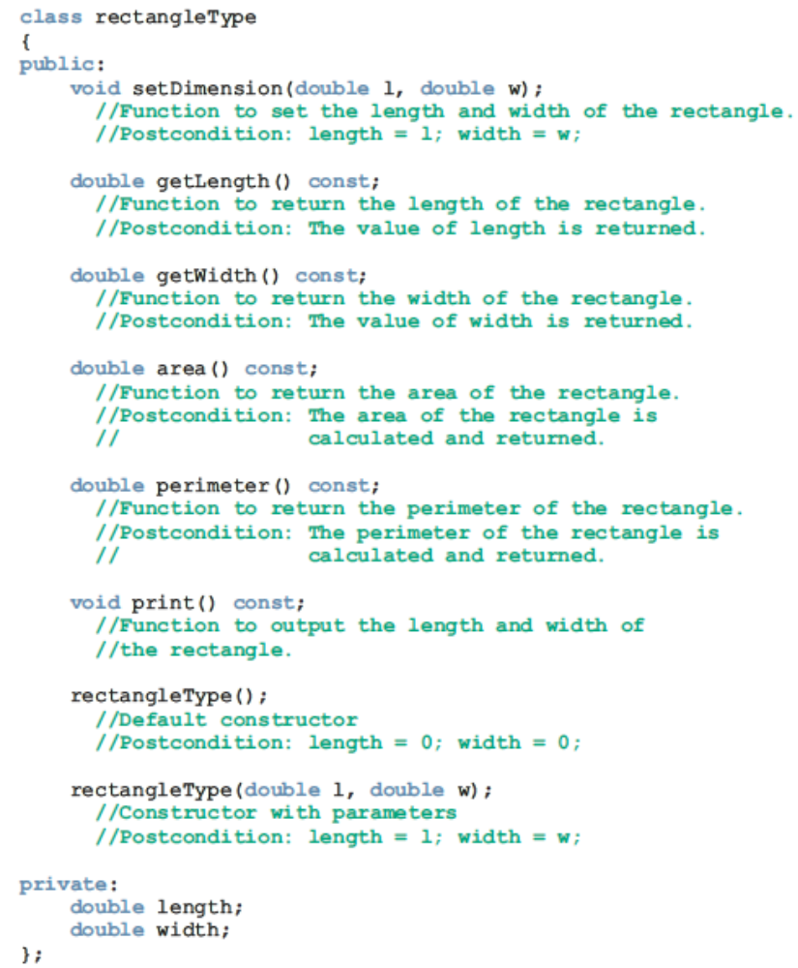
C++ Programming: From Problem Analysis to Program Design, Sixth Edition

Slide 14
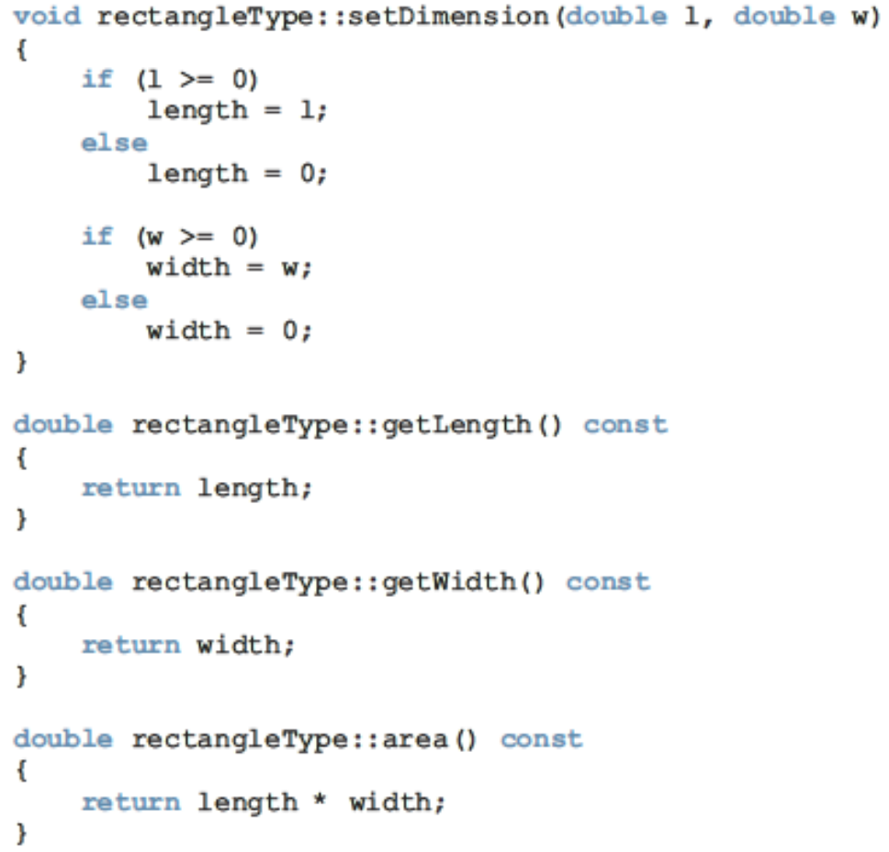
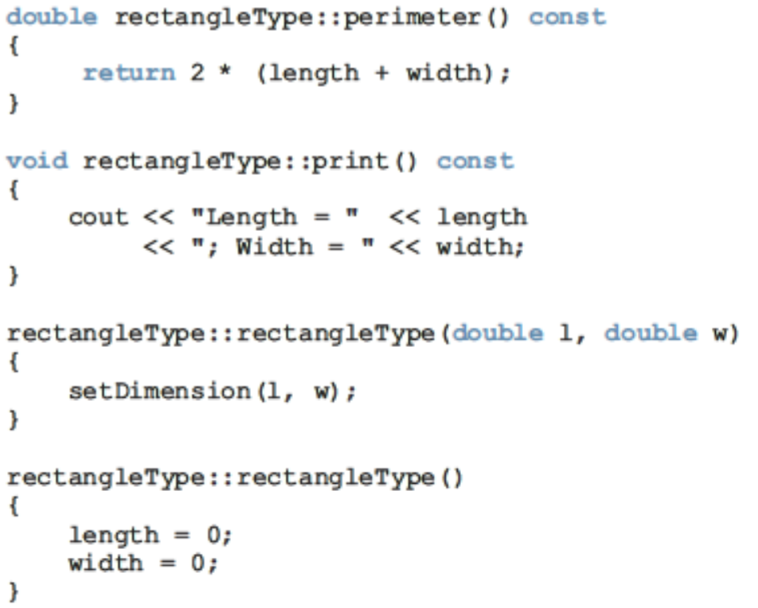
C++ Programming: From Problem Analysis to Program Design, Sixth Edition

Slide 15
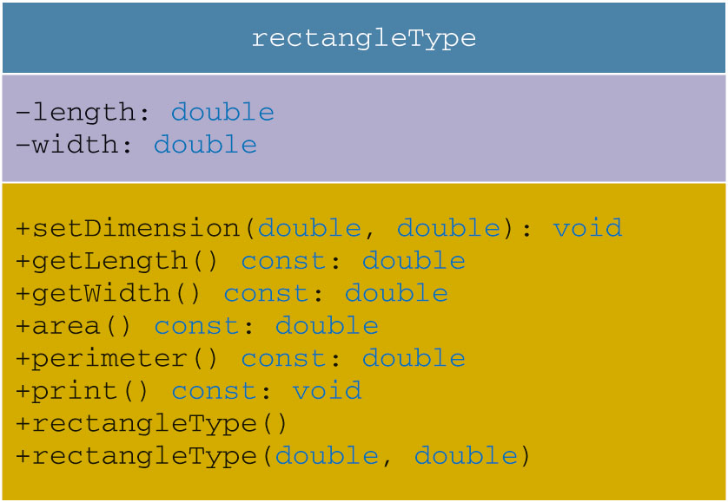
Redefining Member Functions of the Base Class (cont’d.)
C++ Programming: From Problem Analysis to Program Design, Sixth Edition

Slide 16
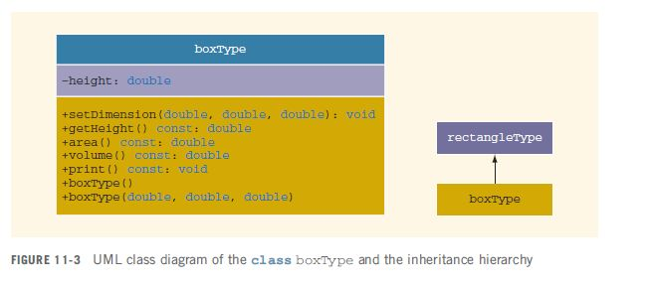
Redefining Member Functions of the Base Class (cont’d.)
boxType is derived from rectangleType, and it is a public inheritance
  Also overrides print and area
void boxType::print() const
{
rectangleType::print();
cout << "; Height = " << height;
}
C++ Programming: From Problem Analysis to Program Design, Sixth Edition
Notes:
class boxType: public rectangleType
void boxType::setDimension(double l, double w, double h)
{
rectangleType::setDimension(l, w);
if (h >= 0)
height = h;
else
height = 0;
}

Slide 17
Constructors of Derived and Base Classes
Derived class constructor cannot directly access private members of the base class
  It can directly initialize only public member variables of the base class
When a derived object is declared, it must execute one of the base class constructors
Call to base class constructor is specified in heading of derived class constructor definition
C++ Programming: From Problem Analysis to Program Design, Sixth Edition

Slide 18
Constructors of Derived and Base Classes
To write the definition of class boxType constructor with parameters,
  first write the class boxТуре constructor heading including all of the раттеtеr needed for both the base class and derived class constructor; that is, all the parameters needed for both boxType and rectangleТype.
  Then, to trigger the execution of the base class constructor with parameters, we add а colon ( :) to the heading followed by the name of the constructor of the base class with its parameters in the heading of the definition of the constructor of the derived class.
C++ Programming: From Problem Analysis to Program Design, Sixth Edition

Slide 19
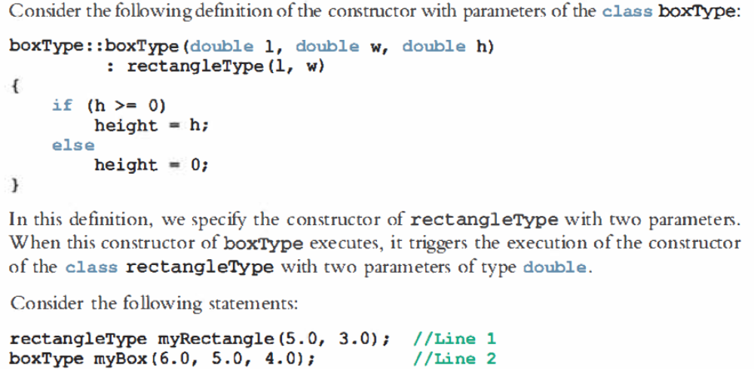
Constructors of Derived and Base Classes
C++ Programming: From Problem Analysis to Program Design, Sixth Edition

Slide 20
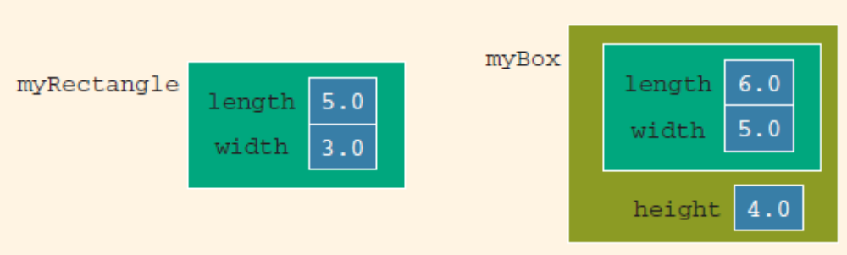
Constructors of Derived and Base Classes
Consider the following definition of the constructor with parameters of the class boxType:
boxType::boxType(double l, double w, double h)
: rectangleType(l, w)
{
if (h >= 0)
height = h;
else
height = 0;
}
Consider the following statements:
rectangleType myRectangle(5.0, 3.0); //Line 1
boxТуре mуВох(6.О, 5.0, 4.0); //Line 2
C++ Programming: From Problem Analysis to Program Design, Sixth Edition
Notes:
In this definition, we specify the consrшctor of rectangleТype with rwo paramerers. When tЬis constшctor оfЬохТуре ехесшеs, it triggers tЬе execution o f the constrпctor of the class rectangleТype witl1 two paraшeters of type douЫe.
The statement in Line 1 creates the rectangleType object myRectangle. Thus, the object myRectangle has two member variables: length and width. The statement in Line 2 creates the boxType object myBox. Thus, the object myBox has three member variables: length, width, and height (see Figure 13-4).
myRectangle.print(); //Line 3 : Length = 5.0; Width = 3.0
cout << endl; //Line 4
myBox.print(); //Line 5 :Length = 6.0; Width = 5.0; Height = 4.0
cout << endl; //Line 6

Slide 21
Destructors in a Derived Class
Destructors: used to deallocate dynamic memory allocated by the objects of a class
When a derived class object goes out of scope
  Automatically invokes its destructor
When the destructor of the derived class executes
  Automatically invokes the destructor of the base class
C++ Programming: From Problem Analysis to Program Design, Sixth Edition

Slide 22
Header File of a Derived Class
To define new classes, create new header files
To create new derived classes, include commands that specify where the base class definitions can be found
Definitions of the member functions can be placed in a separate file
C++ Programming: From Problem Analysis to Program Design, Sixth Edition

Slide 23
Multiple Inclusions of a Header File
Use the preprocessor command (#include) to include a header file in a program
  Preprocessor processes the program before it is compiled
To avoid multiple inclusion of a file in a program, use certain preprocessor commands in the header file
C++ Programming: From Problem Analysis to Program Design, Sixth Edition

Slide 24
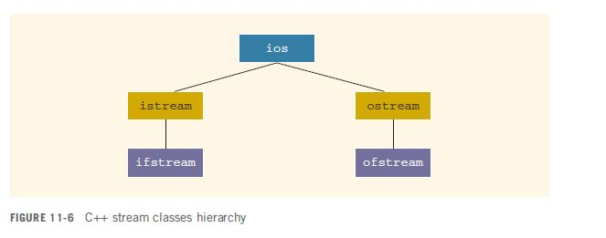
C++ Stream Classes
ios is the base class for all stream classes
  Contains formatting flags and member functions to access/modify the flag settings
C++ Programming: From Problem Analysis to Program Design, Sixth Edition

Slide 25
C++ Stream Classes (cont’d.)
istream and ostream provide operations for data transfer between memory and devices
  istream defines the extraction operator (>>) and functions get and ignore
  ostream defines the insertion operator (<<) which is used by cout
ifstream/ofstream objects are for file I/O
  Header file fstream contains the definitions for these
C++ Programming: From Problem Analysis to Program Design, Sixth Edition

Slide 26
Protected Members of a Class
Derived class cannot directly access private members of it base class
  To give it direct access, declare that member as protected
C++ Programming: From Problem Analysis to Program Design, Sixth Edition

Slide 27
Inheritance as public, protected, or private
Assume class B is derived from class A with
If memberAccessSpecifier is public:
  public members of A are public in B, and can be directly accessed in class B
  protected members of A are protected in B, and can be directly accessed by member functions (and friend functions) of B
  private members of A are hidden in B and can be accessed only through public or protected members of A
C++ Programming: From Problem Analysis to Program Design, Sixth Edition

Slide 28
Inheritance as public, protected, or private (cont’d.)
If memberAccessSpecifier is protected:
  public members of A are protected members of B and can be accessed by the member functions (and friend functions) of B
  protected members of A are protected members of B and can be accessed by the member functions (and friend functions) of B
  private members of A are hidden in B and can be accessed only through public or protected members of A
C++ Programming: From Problem Analysis to Program Design, Sixth Edition

Slide 29
Inheritance as public, protected, or private (cont’d.)
If memberAccessSpecifier is private:
  public members of A are private members of B and can be accessed by member functions of B
  protected members of A are private members of B and can be accessed by member functions (and friend functions) of B
  private members of A are hidden in B and can be accessed only through public/protected members of A
C++ Programming: From Problem Analysis to Program Design, Sixth Edition

Slide 30
Composition (Aggregation)
In composition, one or more member(s) of a class are objects of another class type
Composition (aggregation): “has-a” relation
Arguments to the constructor of a member-object are specified in the heading part of the definition of the constructor
C++ Programming: From Problem Analysis to Program Design, Sixth Edition

Slide 31
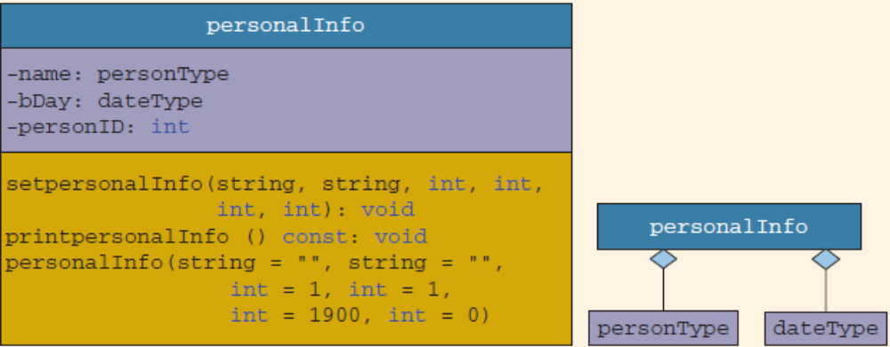
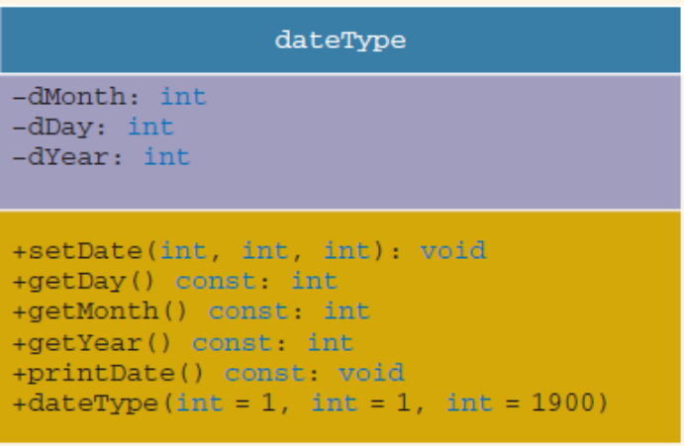
Composition (Aggregation)
The class personType stores a person’s first name and last name. Suppose we want to keep track of additional information for a person, such as a personal ID (e.g., a Social Security number), we can define a new class, called personalInfo
First, we define another class, dateType, to store only a person’s date of birth. Then, we construct the class personalInfo from the classes personType and dateType.
C++ Programming: From Problem Analysis to Program Design, Sixth Edition

Slide 32
Composition (Aggregation) (cont’d.)
Member-objects of a class are constructed in the order they are declared
  Not in the order listed in the constructor’s member initialization list
They are constructed before the containing class objects are constructed
C++ Programming: From Problem Analysis to Program Design, Sixth Edition

Slide 33
Object-Oriented Design (OOD) and Object-Oriented Programming (OOP)
The fundamental principles of object-oriented design (OOD) are:
  Encapsulation: combines data and operations on data in a single unit
  Inheritance: creates new objects (classes) from existing objects (classes)
  Polymorphism: the ability to use the same expression to denote different operations
C++ Programming: From Problem Analysis to Program Design, Sixth Edition

Slide 34
OOD and OOP (cont’d.)
In OOD:
  Object is a fundamental entity
  Debug at the class level
  A program is a collection of interacting objects
OOD encourages code reuse
Object-oriented programming (OOP) implements OOD
C++ Programming: From Problem Analysis to Program Design, Sixth Edition

Slide 35
OOD and OOP (cont’d.)
C++ supports OOP through the use of classes
Function name and operators can be overloaded
Polymorphic function or operator: has many forms
  Example: division with floating point and division with integer operands
C++ Programming: From Problem Analysis to Program Design, Sixth Edition

Slide 36
OOD and OOP (cont’d.)
Templates provide parametric polymorphism
C++ provides virtual functions to implement polymorphism in an inheritance hierarchy
  Allows run-time selection of appropriate member functions
Objects are created when class variables are declared
Objects interact with each other via function calls
C++ Programming: From Problem Analysis to Program Design, Sixth Edition

Slide 37
OOD and OOP (cont’d.)
Every object has an internal state and external state
  Private members form the internal state
  Public members form the external state
Only the object can manipulate its internal state
C++ Programming: From Problem Analysis to Program Design, Sixth Edition

Slide 38
Identifying Classes, Objects, and Operations
To find classes: begin with a problem description and identify all nouns and verbs
  From the list of nouns choose the classes
  From the list of verbs choose the operations
Suppose we want to write a program that calculates and prints the volume and surface area of a cylinder
C++ Programming: From Problem Analysis to Program Design, Sixth Edition

Slide 39
Identifying Classes, Objects, and Operations (cont’d.)
State this problem as follows:
  Write a program to input the dimensions of a cylinder and calculate and print the surface area and volume
  Nouns are bold and verbs are italic
  From the list of nouns, can visualize a cylinder as a class (cylinderType) from which we can create many cylinder objects of various dimensions
C++ Programming: From Problem Analysis to Program Design, Sixth Edition
Notes:
Volume: π × r² × h
Surface area: 2 × π × r × (r + h)
Number of faces: 2

Slide 40
Identifying Classes, Objects, and Operations (cont’d.)
These nouns are characteristics of a cylinder, so they will not be classes:
  Dimensions
  Surface area
  Volume
Next, determine three pieces of information about this class:
  Operations that an object can perform
  Operations that can be performed on an object
  Information that an object must maintain
C++ Programming: From Problem Analysis to Program Design, Sixth Edition

Slide 41
Identifying Classes, Objects, and Operations (cont’d.)
From the verbs, list possible operations that an object of that class can perform, or have performed, on itself
  For the cylinderType class:
    Input
    Calculate
    Print
  Dimensions of the cylinder represent the class’s data
C++ Programming: From Problem Analysis to Program Design, Sixth Edition

Slide 42
Identifying Classes, Objects, and Operations (cont’d.)
Identifying classes via nouns and verbs from problem descriptions is not the only technique possible
There are several other OOD techniques in the literature
C++ Programming: From Problem Analysis to Program Design, Sixth Edition

Slide 43
Summary
Inheritance and composition are meaningful ways to relate two or more classes
Inheritance is an “is-a” relation
  Single inheritance: a derived class is derived from one class, called the base class
  Multiple inheritance: a derived class is derived from more than one base class
Composition is a “has-a” relation
C++ Programming: From Problem Analysis to Program Design, Sixth Edition

Slide 44
Summary (cont’d.)
Private members of a base class are private to the base class
Public members of a base class can be inherited either as public or private
Derived class can redefine function members of a base class
  Redefinition applies only to objects of derived class
C++ Programming: From Problem Analysis to Program Design, Sixth Edition

Slide 45
Summary (cont’d.)
A call to a base class constructor (with parameters) is specified in the heading of the definition of the derived class constructor
When initializing object of a derived class, the base class constructor is executed first
In composition (aggregation):
  Class member is an object of another class
  Call to constructor of member objects is specified in heading of the definition of class’s constructor
C++ Programming: From Problem Analysis to Program Design, Sixth Edition

Slide 46
Summary (cont’d.)
Three basic principles of OOD:
  Encapsulation
  Inheritance
  Polymorphism
To find classes:
  Describe the problem
  Choose classes from the list of nouns
  Choose operations from the list of verbs
C++ Programming: From Problem Analysis to Program Design, Sixth Edition

